Slide 1

Hypokalemia
Kari Bernhardt
University of Mary
NUR 519 Advanced Pathophysiology
Dr. Cheryl Rising & Dr. Teree Rittenbach
September 30th, 2020

Slide 2

Introduction
Major intracellular electrolyte
Pump – K+ - IN
Normal Range is 3.5 to 5 mEq/L
Serum potassium less than 3.5 = hypokalemia
Essential for muscles
Excitability and contraction
(McCance & Huether, 2019)
Notes:
98% of total body K is intracellularly and it is chiefly in the muscles
Excreted in (90%) urine and (10%) feces
Na+K+ATPase: almost all cless contain this pump, it is required for maintenance of ICF and ECF through electromechanical gradiet
Essential electrolyte for muscles, cardiovascular system (heart is a muscle), central nervous system, respiratory system
Hypokalemia is a common clinical problem. Potassium enters the body via oral intake or intravenous infusion, is largely stored in the cells, and then excreted in the urine. Thus, decreased intake, increased translocation into the cells, or, most often, increased losses in the urine, gastrointestinal tract, or sweat can lead to a reduction in the serum potassium concentration

Slide 3
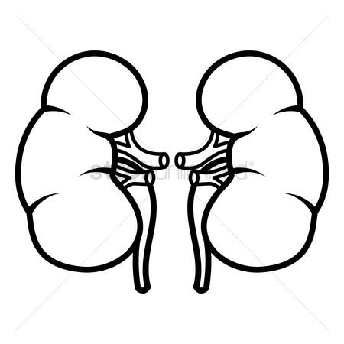
Etiology
Inadequate Potassium Intake
Increased Potassium excretion
Shift from extracellular to the intracellular space
(Lederer, 2018)
Notes:
1. Inadequate Potassium Intake
Eating disorders
Anorexia, bulimia, starvation, alcoholism
Dental Problems
Poverty
Tea and toast diet of the elderly
2. Increased Potassium excretion
Mineralocorticoid issues
Cushing's
Hyperaldosteronism
Hypo magnesium
Steroid therapy
GI losses (Vomiting and diarrhea)
Medications
Diuretics
Genetic Disorders
Glucocorticoid receptor deficiency
Seizures
3. Shift from extracellular to the intracellular space
Alkalosis
Insulin administration (draws potassium out)

Slide 4

Test your Knowledge
The nurse is teaching a patient with hypokalemia about foods high in potassium. Which food items does the nurse recommend to this patient? a. Lettuce b. Cantaloupe c. Potatoes d. Peaches

Slide 5
Answer
The nurse is teaching a patient with hypokalemia about foods high in potassium. Which food items does the nurse recommend to this patient? (Select all that apply.)
B. Cantaloupe C. Potatoes

Slide 6
High in Potassium
Low in potassium
Bananas
Apricots
Spinach
Broccoli
Potatoes
Chocolate
Tuna
Soybeans
Apples
Blueberries
Grapes
Asparagus
Cabbage
Kale
Peppers
Cooked carrots
(Lewis, 2020)

Slide 7
Epidemiology
Less than 1% of people who are not taking medication
21% of hospitalized patients
5% of elderly
20-50% of patients taking non-sparing diuretics
(Lederer, 2018)
Notes:
Less than 1% of people who are not taking medication
Increased risk for females
Younger age
Higher estimate glomerular filtration rate
Use of diuretics
21% of hospitalized patients
People with low potassium have multiple medical problems
High morbidity and mortality related to cardiac arrhythmias or sudden cardiac death
5% of elderly
Increases with age because of diuretic use and potassium poor diets
20-50% of patients taking non-sparing diuretics

Slide 8
Pathophysiology
Alterations in Na-K-ATPase transport
Loss of total body potassium
Urinary loss of potassium
Diuretics
Insulin administration
Alkalosis
Reduced intake of potassium
(McCance & Huether, 2019)
Notes:
Increased K into the cells
98% total body is ICF
Balance is maintained by the Na-K-ATPase pump
Alteration in the potassium transport pathways can result in transient hypokalemia = increase K into cells
**insulin promotes entry of potassium into skeletal muscle and hepatic cells, does this by increased activity of the N-k-ATPase pump**
Usually given in DKA
Insulin release from carbohydrate load
When serum K concentration decreases to less than 3.5 mEq/
Found intracellular which is hard to measure so when changes in K balance are described referring to the plasma concentration
Commonly, low K means loss of total body K
Potassium is lost from the ECF
Concentration gradient favors movement of potassium from the cell to outside of the cell
ICF/ECF concentration ratio is maintained
Reduced K intake (low protein intake, inadequate intake of fruits and vegetables)
normal intake is 40-120 mEq per day then excreted in urine
kidney lowers excretion to 5-25 mEq
** reduced intake rarely causes significant hypokalemia
One study: reduced intake changed 4.1 to 3.5
Combine reduced intake with diuretic therapy we have an issue
Redistribution between ECF and ICF
Most commonly caused by Respiratory Alkalosis & Metabolic Alkalosis (vomiting)
ECF Hydrogen ions move out of the cell to help correct the alkalosis which in return causes K to move into the cell to help maintain an ionic balance
Insulin promotes cellular uptake of K

Slide 9

Pertinent History Questions
Medication usage
Diet
Alcohol consumption
Recent illness
(Mount, 2020)

Slide 10
Test your knowledge
The patient's potassium level is 2.5 meq/L. Which clinical findings does the nurse expect to see when assessing this patient? (Select all that apply.) A. General skeletal muscle weakness b. Moist crackles and tachypnea c. Lethargy d. Increased specific gravity and decreased urine output e. Weak hand grasps

Slide 11
Answer
The patient's potassium level is 2.5 mEq/L. Which clinical findings does the nurse expect to see when assessing this patient? (Select all that apply.) a. General skeletal muscle weakness b. Moist crackles and tachypnea c. Lethargy d. Increased specific gravity and decreased urine output e. Weak hand grasps

Slide 12
Most Common Manifestations
Generalized weakness
Fatigue
Dyspnea
Constipation
Palpitations
Muscle cramping
(Saladin, 2018)

Slide 13
Expected Physical Exam Findings
Typical within reference range
May see abnormalities in vital signs
Muscle Weakness
Cardiac
Respiratory
Skeletal
Gastrointestinal
Tooth erosion
(Lederer, 2018)
Notes:
Usually do not manifest until less than 3.0
Unless it falls rapidly because of factors like digitalis and arrhythmias
Muscle weakness typically does not manifest until less than 2.5
Begins in lower extremities and progresses to the trunk and upper extremities, may worsen to the point of paralysis
EKG changes
Depressed ST segment
Decreases T wave amplitude
May see U waves
Prolonged QT interval

Slide 14
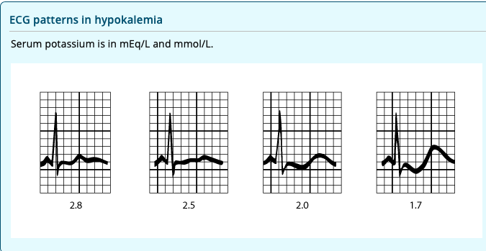
Diagnostic testing/Labs
Basic metabolic panel
Measurement of urine potassium
Establishes pathologic mechanism
Electrocardiogram (ECG)
Cardiac function
Digoxin toxicity
(Mount, 2020)
(Lewis, 2020)
Notes:
Establishes the pathophysiologic mechanism and help formulate the differential diagnosis – guides the choice of further tests
After acidosis and other causes of intracellular potassium shift have been eliminated, 24-hour urinary potassium and serum magnesium concentrations are measured.
Urine less than 20
Diarrhea and laxative use
Diet
Use of insulin
Higher than 40
Vomiting
Mineralocorticoid excess
EKG changes
Depressed ST segment
Decreases T wave amplitude
May see U waves
Prolonged QT interval

Slide 15
Complications
Cardiac arrhythmias
Bradycardia
Cardiovascular collapse
Acute respiratory failure
Death
(McCance & Huether, 2019)
Notes:
Severe hypokalemia may manifest as bradycardia with cardiovascular collapse. Cardiac arrhythmias and acute respiratory failure from muscle paralysis are life-threatening complications that require immediate diagnosis.

Slide 16
Test Your Knowledge
The nurse administering potassium to a patient carefully monitors the infusion because of the risk for which condition?
a. Pulmonary edema b. Cardiac dysrhythmia c. Postural hypotension d. Renal failure

Slide 17
Answer
The nurse administering potassium to a patient carefully monitors the infusion because of the risk for which condition?
a. Pulmonary edema b. Cardiac dysrhythmia c. Postural hypotension d. Renal failure

Slide 18
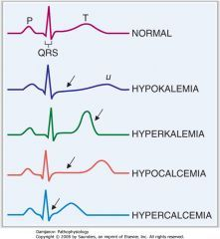
(Saladin, 2018)

Slide 19
Treatment & Management
Reduce
Replenish
Evaluate
Prevent
(Lederer, 2018)
Notes:
Prevent life threatening complications like arrhythmia and respiratory failure
Prevent life threatening complications
Identify underlying etiology
Correct K+ deficiet
Minimise ongoing losses
Prevention of hypokalemia

Slide 20
Conclusion
Intracellular fluid electrolyte
Helps carry electrical signals between cells
Cells rely on electrical signals to work right
Essential for muscle function
Main symptom is muscle weakness
Effects cardiac function
Severe cases effect respiratory system
Thorough medical history and physical assessment
Oral or IV replacement
(McCance & Huether, 2019)

Slide 21

Questions?

Slide 22
References
Lederer, E. (2018, December 6). Hypokalemia: Practice essentials, pathophysiology, etiology. Medscape. https://emedicine.medscape.com/article/242008-overview
Lewis, J. L. (2020). Hypokalemia - endocrine and metabolic disorders - merck manuals professional edition. Merck Manuals Professional Edition. https://www.merckmanuals.com/professional/endocrine-and-metabolic-disorders/electrolyte-disorders/hypokalemia
McCance, K. L., & Huether, S. E. (2019). Pathophysiology: The biological basis for disease in adults and children (8th ed.). Elsevier .
Mount, D. B. (2020, March 9). Causes of hypokalemia in adults. UpToDatte. https://www-uptodate-com.ezproxy.umary.edu/contents/causes-of-hypokalemia-in-adults?search=diagnosising hypokalemia
Mount, D. B. (2020, May 26). Evaluation of the adult patient with hypokalemia. UpToDate. https://www-uptodate-com.ezproxy.umary.edu/contents/evaluation-of-the-adult-patient-with-hypokalemia?search=diagnosising hypokalemia
Saladin, K. S. (2018 ). Anatomy and Physiology: The unity of form and function (8th ed.). McGraw Hill Education .

